Slide 1

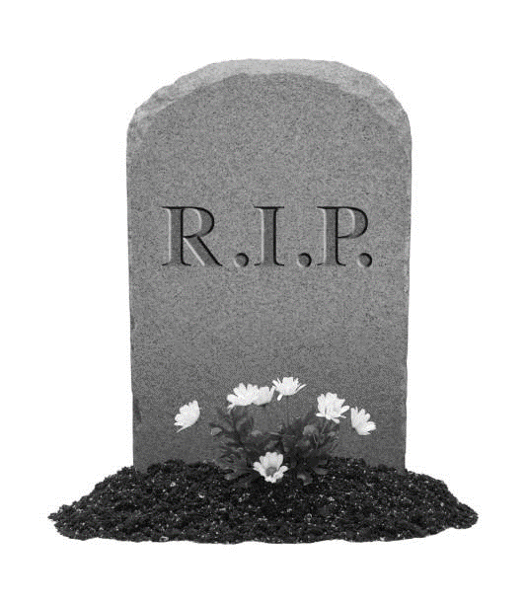
John Reinick

Slide 2
Burials
Approx. 19738 burials on record across 27 acres
1372 burials in 1864
July is the most common month with 2352
September 1866 had the most buried in a month with 441-consumption
July 6th is the most common day with 106
Oldest burial on record is Pamela Cordell on Jan/2/1846
Newest burial on record is Bessie Davis Sep/19/1979

Slide 3
Ages
38% of all burials are infants
Next highest age group are 21–30 year olds with 6%
52% of all burials are under 30
36 people who were >99
2 people were 116

Slide 4
People
Most common male name in the cemetery is John with 645
Most common female name Is Mary with 563
11th President of the US James K. Polk was buried here in 1849 (later moved)

Slide 5
Deaths
Brokin Hart
By Vyolence
Kild by Derrick
4 people in automobile accidents between 1865-76
63 different ways to spell diarrhea
June had 115 deaths from the cold, more than any other month
Froze to death in August, died of heat in December
1855 killed by an electric car
179 infants died of old age
11 Marys died of typhoid fever

